Slide 1
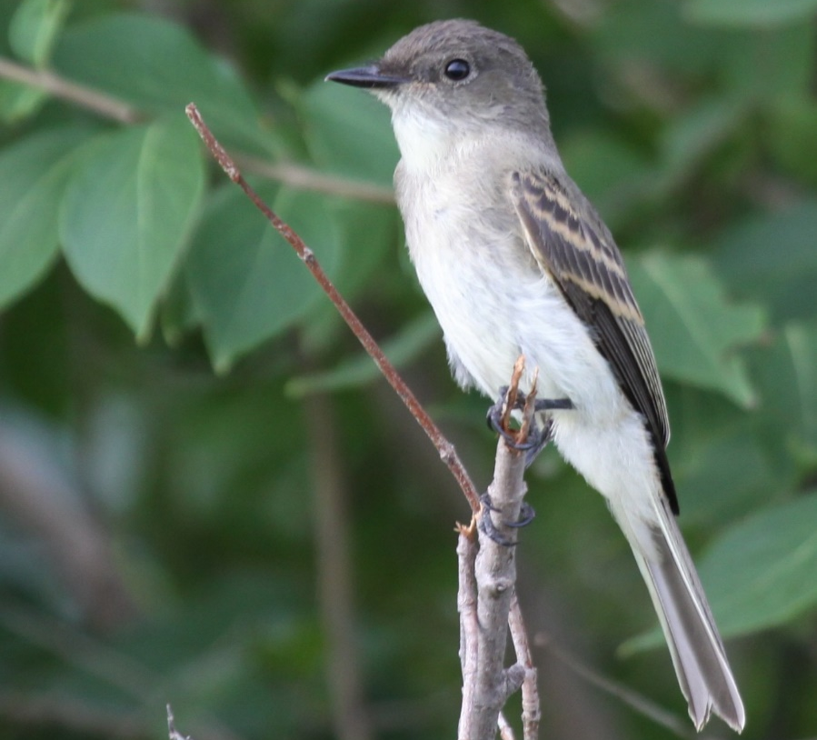
Occupancy Modeling of Eastern Wood-Pewees
Benjamin M. West

Slide 2
Introduction
My study focuses on breeding birds designated as Iowa Species of Greatest Conservation Need (SGCN) in south-central Iowa forests
I want to know
Where avian SCGNs are likely to occur
The relationship between occupancy and habitat characteristics

Slide 3
Example Species: Eastern Wood-Pewee
Eastern Wood-Pewees (Contopus virens) are:
A Species of Greatest Conservation Need in Iowa
Forest-dwelling
Pretty common in my study area
381/501 sites known to
be occupied in 2019

Slide 4
Model
Latent variable: Is the site occupied?
True occupancy state of site i during breeding season

Slide 5
Model
True occupancy state of site i during breeding season
Occupancy probability (ψi)
~Bernoulli
Prior ~ uniform (0,1)

Slide 6
Model
Occupancy covariates*
*Occupancy covariates
tree species richness
live basal area
oak proportion (basal area)
canopy closure
shrub density
forest cover in 1 km radius
forest cover in 10 km radius
logit(ψi) = b0 + bx
True occupancy state of site i during breeding season
Occupancy probability (ψi)
~Bernoulli
Prior ~ uniform (0,1)

Slide 7
Model
Bird detected on a visit (j)
Occupancy covariates
True occupancy state of site i during breeding season
logit(ψi) = b0 + bx
Occupancy probability (ψi)
~Bernoulli
Prior ~ uniform (0,1)

Slide 8
Model
Bird detected on a visit (j)
Occupancy covariates
True occupancy state of site i during breeding season
logit(ψi) = b0 + bx
Occupancy probability (ψi)
Detection probability on a visit (pi,j)
~Bernoulli
Prior ~ uniform (0,1)
~Bernoulli
Prior ~ uniform (0,1)

Slide 9
Model
Bird detected on a visit (j)
Occupancy covariates
Detection covariates**
True occupancy state of site i during breeding season
**Detection covariates:
time since sunrise (cont. w/ quadratic)
Julian day (cont. w/ quadratic)
observer (binary)
logit(ψi) = b0 + bx
logit(pi,j) = b0 + b1x [+ b2x^2]
Occupancy probability (ψi)
Detection probability on a visit (pi,j)
~Bernoulli
Prior ~ uniform (0,1)
~Bernoulli
Prior ~ uniform (0,1)

Slide 10
Model
Bird detected on 1st visit
Bird detected on 2nd visit
*Occupancy covariates
tree species richness
live basal area
oak proportion (basal area)
canopy closure
shrub density
forest cover in 1 km radius
forest cover in 10 km radius
Occupancy covariates*
Detection covariates**
logit(pi,1) = b0 + b1x [+ b2x^2]
logit(ψi) = b0 + bx
True occupancy state of site i during breeding season
logit(pi,2) = b0 + b1x [+ b2x^2]
**Detection covariates:
time since sunrise (cont. w/ quadratic)
Julian day (cont. w/ quadratic)
observer (binary)
Occupancy probability (ψi)
Detection probability on first visit (pi,1)
Detection probability on second visit (pi,2)
~Bernoulli
Prior ~ uniform (0,1)
~Bernoulli
Prior ~ uniform (0,1)
~Bernoulli
Prior ~ uniform (0,1)

Slide 11
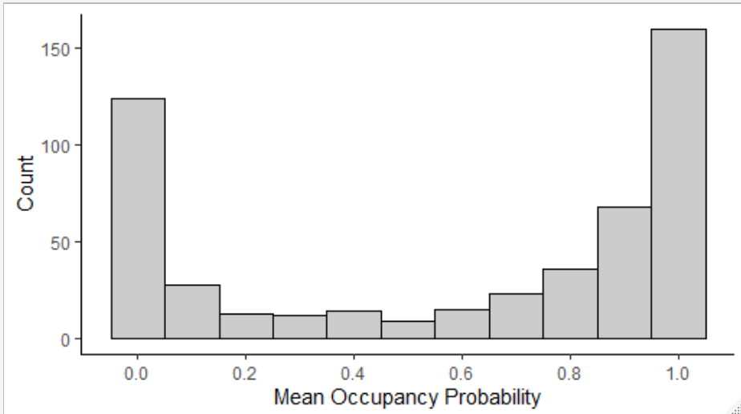
Results
Observed number of sites with at least one detection: 381
381 sites have occupancy probability >0.0426

Slide 12
Results
Parameter | Coefficient (mean) | 2.5% c.i. bound | 97.5% c.i. bound | c.i. width | detection or occupancy?
Prop. Oak | 5.6 | 2.2 | 9.3 | 7.1 | occupancy
Live tree basal area | 4.3 | 0.8 | 8.5 | 7.7 | occupancy
Prop. Forest in 10 km | 2.5 | -0.2 | 5.6 | 5.8 | occupancy
Canopy Closure | 1.5 | -2.9 | 6.5 | 9.4 | occupancy
Prop. Forest in 1 km | 1.3 | -2.0 | 4.8 | 6.8 | occupancy
Observer | 1.1 | 0.7 | 1.4 | 0.7 | detection

Slide 13
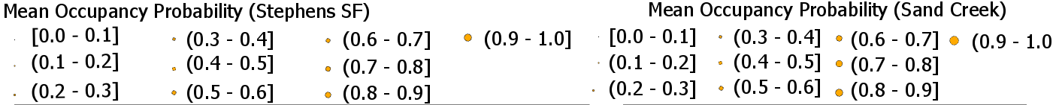
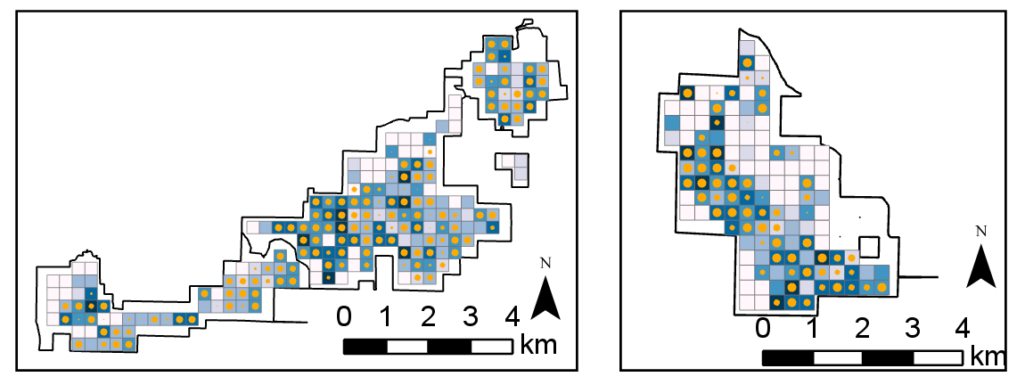
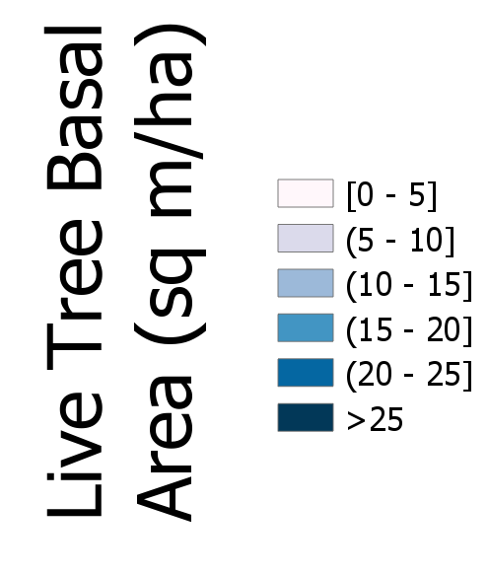
Results

Slide 14
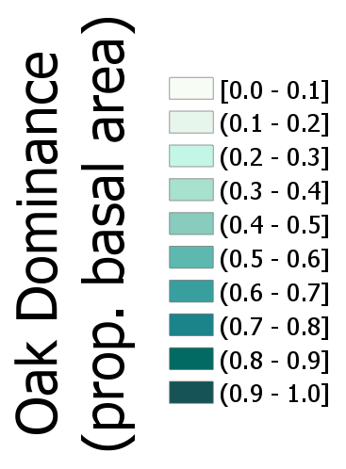
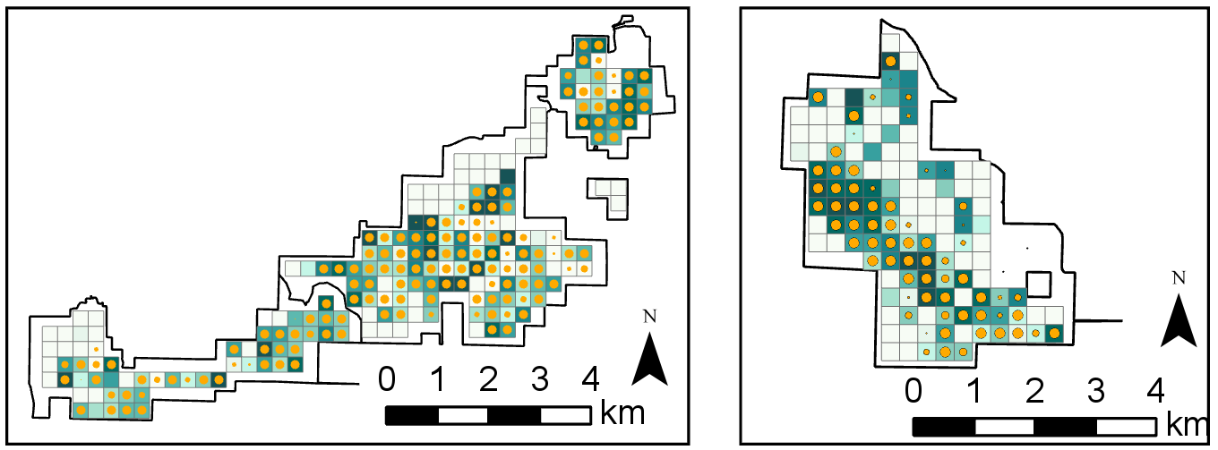
Results

Slide 15
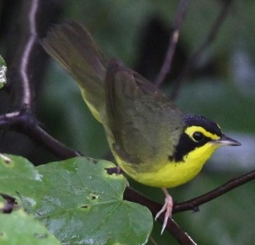
Does this model work for another, rarer species?

Slide 16
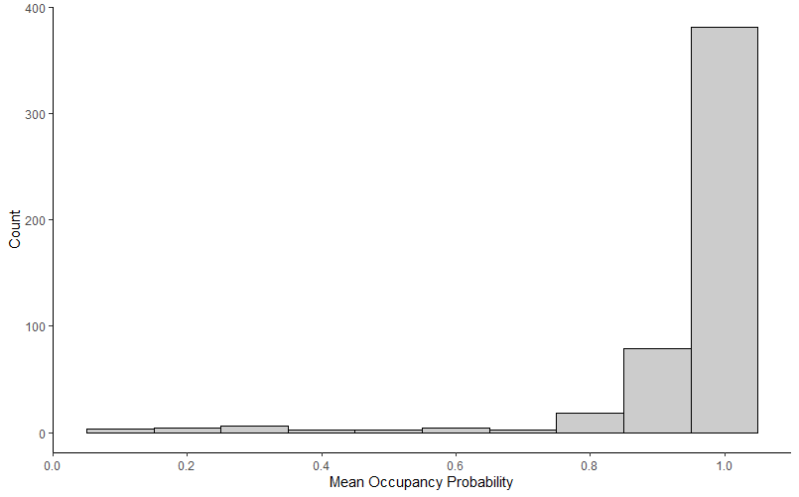
Answer: Not really…
Kentucky Warbler observed at 28 sites
>90% occupancy probability at 440 sites
Only covariates with c.i.’s not crossing zero are intercept and observer

Slide 17
Discussion
Model as currently parameterized:
Gives conservative occupancy estimates for Eastern Wood-Pewees
Has surprisingly few significant covariates
Does not work for much rarer Kentucky Warbler

Slide 18
Discussion
Model might benefit from:
Additional habitat covariates
More visits to each site within a season
Forcing occupied sites to have a high occupancy probability

Slide 19
Acknowledgments
U.S. Forest Service (USDA) and Iowa Department of Natural Resources for funding
Audrey McCombs and Dr. Philip Dixon for coding the model
Jacob Newton, Connor Langan, Sonia Howlett, and Logan Hatfield for 2019 project assistance

Slide 20
Questions?

